Slide 1
CS 4215: Quantitative Performance Evaluation for Computing ystems
Lydia Y. Chen
y.chen-10@tudelft.nl

Slide 2
Modern computing systems
Server
Number of servers
Number of cores
Memory
Cache
Communication
Workload
Arrival rate
Applications
Number of threads

Slide 3

You will learn …
Which system design has the lowest average latency?
μ
μ
μ
μ
λ
jobs
λ
jobs
λ
jobs
kμ
sec
sec
sec
μ
μ

Slide 4
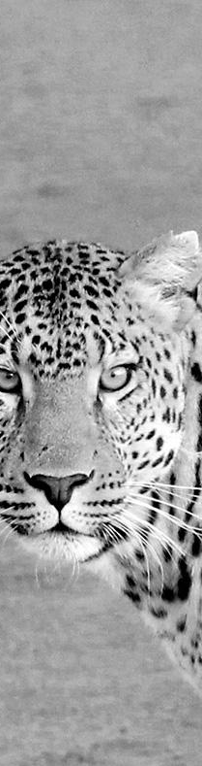
Last week
Operational Laws
Littles Law
Forced Law
Utilization Law
Asymptotic Bounds

Slide 5
Terminology

Slide 6
Basic Components of a Queue
1. Arrival
process
6. Service
discipline
2. Service time
distribution
4. Waiting
positions
3. Number of
servers

Slide 7
Kendall Notation A/S/m/B/K/SD
A: Arrival process
S: Service time distribution
m: Number of servers
B: Number of buffers (system capacity)
K: Population size, and
SD: Service discipline
M: Exponential
E_{k}: Erlang M: Exponential
E_{k}: Erlang with parameter k
H_{k}: Hyper-exponential with parameter k
D: Deterministic  constant
G: General All
G: General  All
Note. Defaults:
Infinite buffer capacity
Infinite population size
FCFS service discipline.
G/G/1 = G/G/1/1/1/FCFS

Slide 8
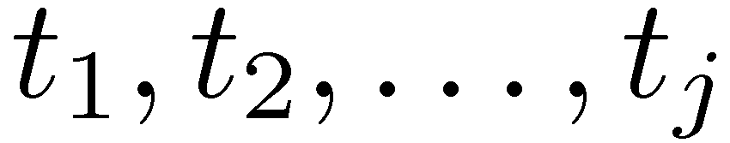
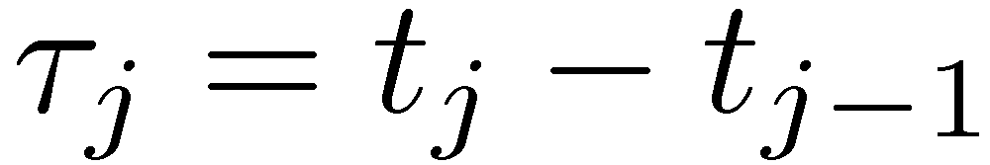
Arrival Process
Arrival times:
Interarrival times:
τ_{j} form a sequence of Independent and Identically Distributed (IID) random variables
Exponential + IID ⇒ Poisson
Notation:
M = Memoryless = Poisson
E = Erlang
H = Hyper-exponential
G = General ⇒ Results valid for all distributions

Slide 9
Service Time
Distribution
Time each student spends at the terminal.
Service times are IID.
Distribution: M (exponential), E (Erlang), H (hyper exponential), or G (general)
Device = Service center = Queue
Buffer = Waiting positions
Discipline
First-Come-First-Served (FCFS)
Last-Come-First-Served (LCFS)
Last-Come-First-Served with Preempt and Resume (LCFS-PR)
Round-Robin (RR) with a fixed quantum.
Small Quantum ⇒ Processor Sharing (PS)
Infinite Server: (IS) = fixed delay
Shortest Processing Time first (SPT)
Shortest Remaining Processing Time first (SRPT)

Slide 10
Example M/M/3/20/1500/FCFS
Time between successive arrivals is exponentially distributed.
Service times are exponentially distributed.
Three servers
20 Buffers = 3 service + 17 waiting. After 20, all arriving jobs are lost
Total of 1500 jobs that can be serviced.
Service discipline is first-come-first-served.

Slide 11
Key Variables
1
2
t = Inter-arrival time = time between two successive arrivals.
λ = Mean arrival rate = 1/E[t]
s = Service time per job.
μ = Mean service rate per server = 1/E[s]
Total service rate for m servers is mm
n = Number of jobs in the system. This is also called queue length.
n_{q} = Number of jobs waiting
n_{s} = Number of jobs receiving service
r = Response time or the time in the system = time waiting + time receiving service
w = Waiting time = Time between arrival and beginning of service
λ
μ
m
n_{q}
n_{s}
n
Previous Arrival
Begin Service
End Service
Arrival
Time
τ
w
s
r

Slide 12



Rules for All Queues
What system is always stable?
Stability Condition
Little’s Law holds
Number in System v.s. Number in Queue
Response time in system v.s. in queue
$${ λ≤mμ}_{i}$$
$$\text{E}\left[N\right]=λE[T]$$
$$E\left[N\right]={E[N}_{Q}]+E[N_{s}]$$
$$Var\left[N\right]=Var[N_{Q}]+Var[N_{s}]$$
What is necessary condition?
$$E\left[T\right]={E[T}_{Q}]+E[T_{s}]$$
$$Var\left[T\right]=Var[T_{Q}]+Var[T_{s}]$$

Slide 13
Single queue

Slide 14
M/M/1 Queue
The most commonly used type of queue
Assumes that the interarrival times and the service times are exponentially distributed and there is only one server.
No buffer or population size limitations and the service discipline is FCFS
Need to know only the mean arrival rate λ and the mean service rate μ.
λ
jobs
μ
jobs
sec
sec

Slide 15
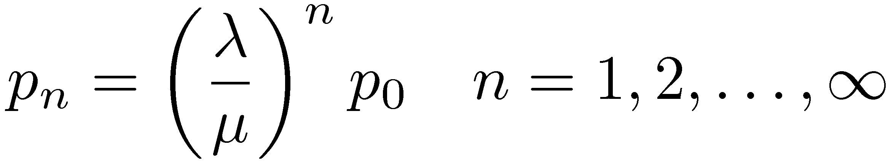
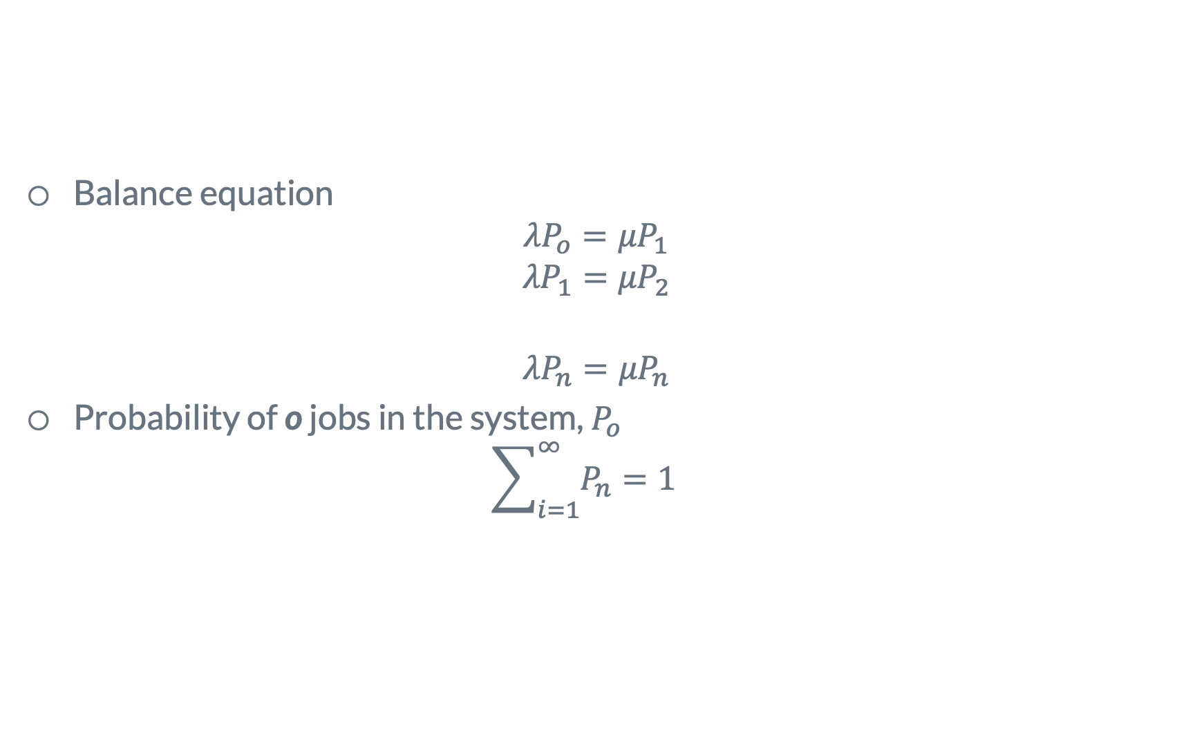
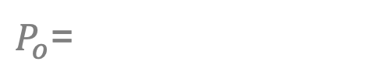
Modeling M/M/1 Queue
What is the state?
λ
λ
λ
λ
λ
λ
Balance equation
$${λP}_{o}={μP}_{1}$$
$${λP}_{1}={μP}_{2}$$
$${λP}_{n}={μP}_{n}$$
Probability of o jobs in the system, $P_{o}$
$${\sum_{i=1}^{∞}{P_{n}}=1}_{}$$
0
1
2
…
J-1
J
J+1
μ
μ
μ
μ
μ
μ
$P_{o}$=

Slide 16
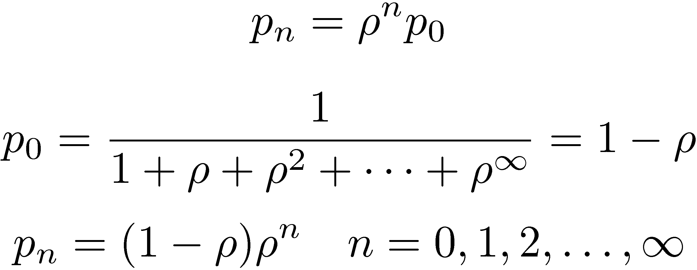
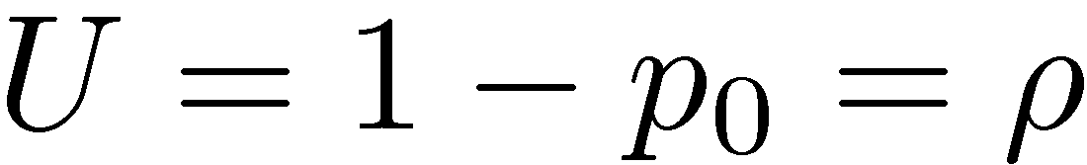
Results for M/M/1 Queue
The quantity l/m is called traffic intensity and is usually denoted by symbol r.

Slide 17
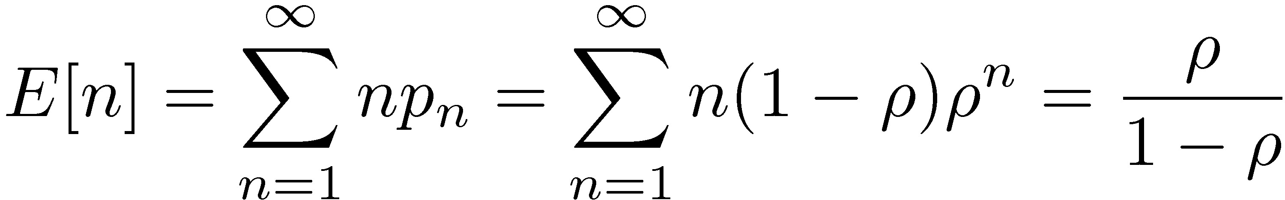
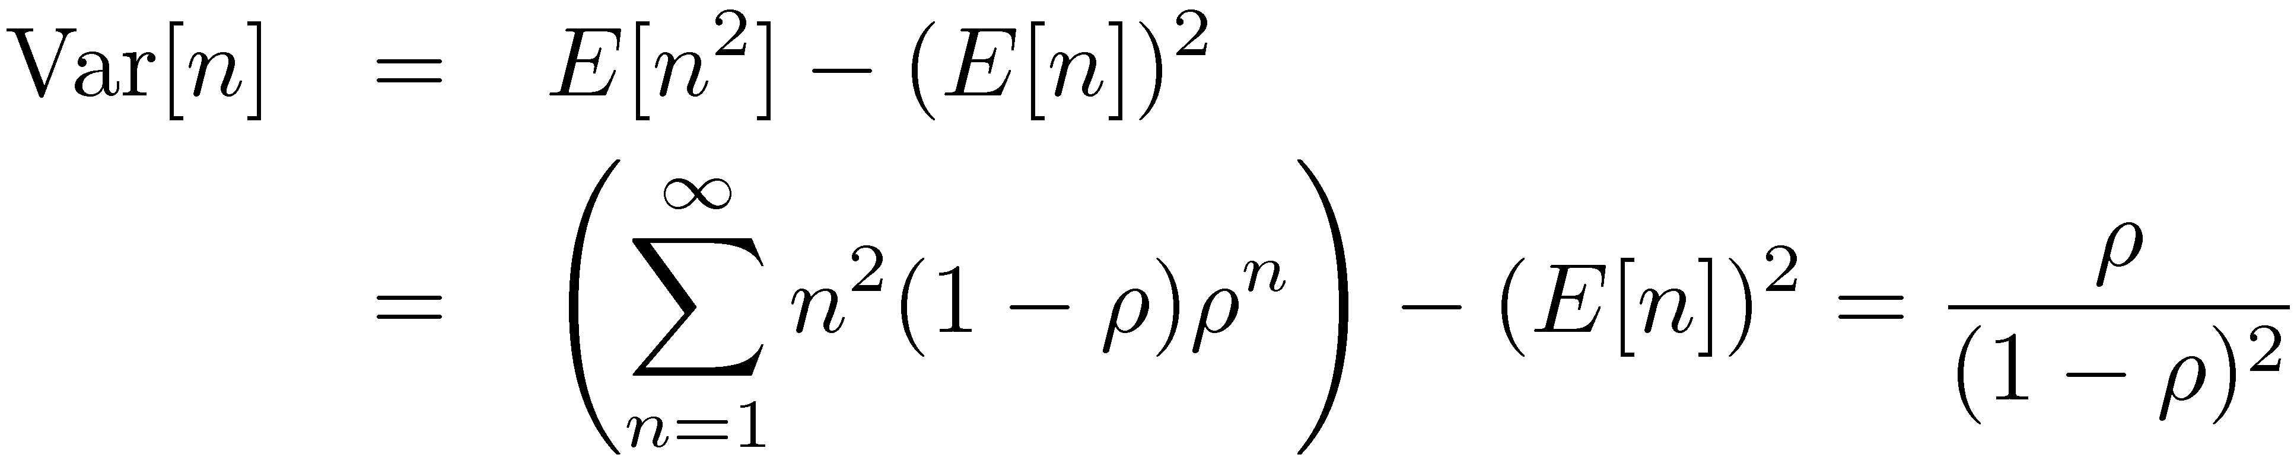
Results for M/M/1 Queue(Cont)
Mean number of jobs in the system:
Variance of the number of jobs in the system:
How?
How?

Slide 18
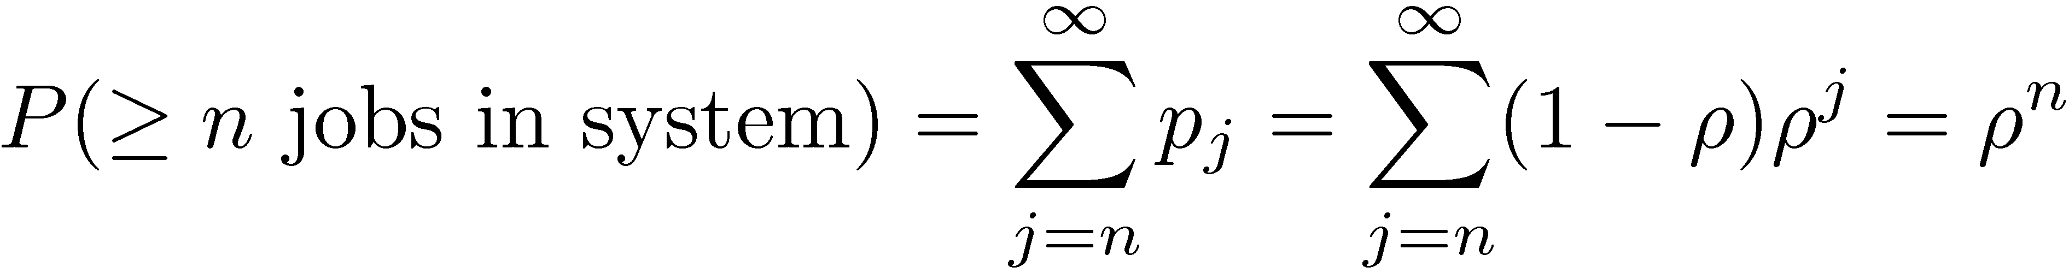
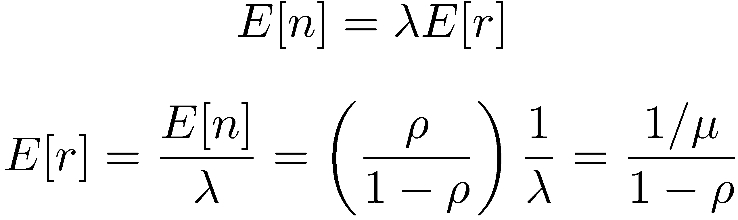
Results for M/M/1 Queue(Cont)
Probability of n or more jobs in the system:
Mean response time
How?
What theorem helps?
How?

Slide 19
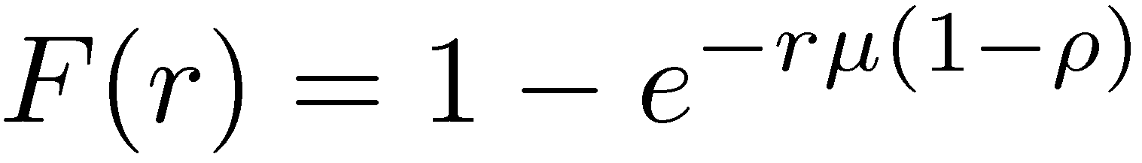
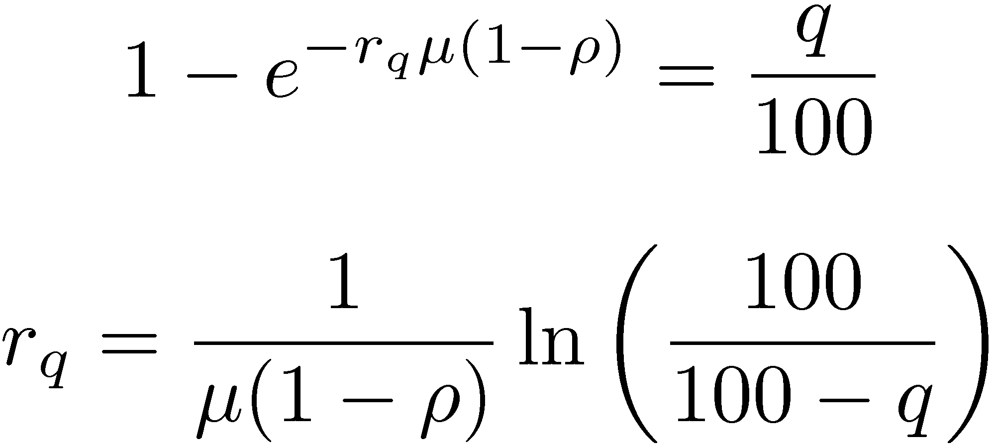
Results for M/M/1 Queue(Cont)
Cumulative distribution function of the response time:
The response time is exponentially distributed. ⇒ q-percentile of the response time
Response time distribution is a HARD problem!!!!!

Slide 20
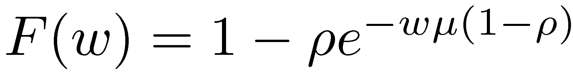
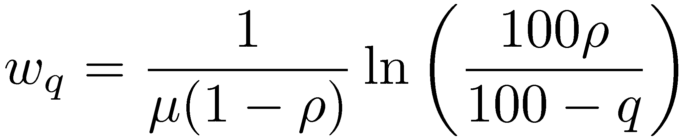
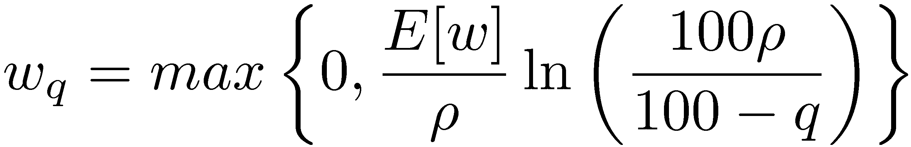
Results for M/M/1 Queue (Advanced)
Cumulative distribution function of the waiting time:
This is a truncated exponential distribution. Its q-percentile is given by:
The above formula applies only if q is greater than 100(1-ρ). All lower percentiles are zero.

Slide 21
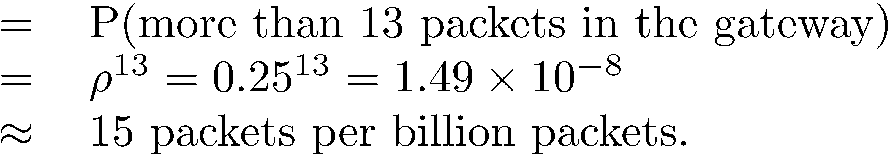
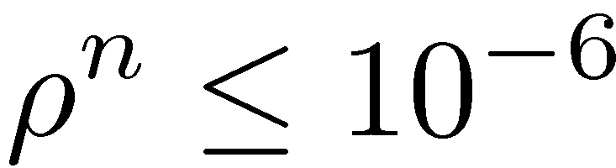
Example of M/</1
On a network gateway, measurements show that the packets arrive at a mean rate of 125 packets per second (pps) and the gateway takes about two milliseconds to forward them. Using an M/M/1 model, analyze the gateway. What is the probability of buffer overflow if the gateway had only 13 buffers? How many buffers do we need to keep packet loss below one packet per million?
Probability of buffer overflow
To limit the probability of loss to less than 10⁻⁶
Arrival rate l = 125 pps
Service rate m = 1/.002 = 500 pps
Gateway utilization U = 0.25

Slide 22
Other queues
M/G/1
G/M/1
G/G/1
What does that mean?

Slide 23
Closed look
Which one has the highest queue?
μ
jobs
λ
jobs
sec
sec
D/D/1
M/M/1
M/G/1
M/G/1,C² = 100
M/G/1 C² = 10
20
Variability matters a lot!
From where?
15
10
M/M/1
5
D/D/1
0
0.2
0.4
0.6
0.8
Notes:
Hi, My name is Mor Harchol-Balter. I’m a professor in the Computer Science Department here at CMU. I’ll be talking about what analytical performance modeling teaches us about designing computer systems. Don’t get nervous about these friends of mine … you’ll meet them all later during the talk….

Slide 24

Inspection paradox
Average waiting time (S) between buses is 10 minutes
time
S
S
S
QUESTION:
On average, how long do I have to wait for a bus?
< 5 min
5 min
10 min
>10 min

Slide 25
Inspection paradox
Wait
time
S
S
S

Slide 26
On average, women spend 88 sec in loo and men spend 40 sec in loo
How about their wait time? ?

Slide 27



Another perspective of variability
λ
ppl
μ
ppl
sec
sec
doubling
ρ
λ
ppl
2μ
ppl
sec
sec
QUESTION:
Women take 2X as long. What’s the difference in their wait?
factor < 2
factor 2
factor 4
factor > 4

Slide 28

Another perspective of variability
λ
ppl
μ
ppl
sec
sec
doubling
ρ
λ
ppl
2μ
ppl
sec
sec
M/M/1
Doubling r can increase E[T_{Q}]
by factor of 4 to ∞
M/G/1

Slide 29
Another perspective of variability
Solutions to reduce the waiting time?
ppl
ppl
λ
μ
sec
sec
Solution 1
ppl
ppl
λ
2μ
ppl
ppl
sec
sec
λ
μ
sec
sec
ppl
ppl
λ
μ
Insufficient!
Waiting time for women is still factor of 2 higher!!!
What else?
sec
sec
ppl
ppl
λ
2μ
sec
sec

Slide 30
Another perspective of variability
Solutions to reduce the waiting time?
ppl
ppl
λ
μ
sec
sec
Solution 2
ppl
ppl
λ
2μ
sec
sec
First, reduce the load
Secondly, smarter scheduling
FCFS (First-Come-First-Served, non-preemptive)
PS (Processor-Sharing, preemptive)
SJF (Shortest-Job-First, non-preemptive)
SRPT (Shortest-Remaining-Processing-Time, preemptive)
Ε[Τ]
PS
9
FCFS
LAS
7
SJF
5
SRPT
3
C²=10
1
0
0.2
0.4
0.6
0.8
1.0
ρ

Slide 31
Multiple servers

Slide 32
M/M/k Queue
The mean arrival rate λ and the mean service rate per server is μ
μ
Poisson
process
with rate
μ
K servers
λ
jobs
sec
μ

Slide 33
Modeling M/M/k Queue
What is the state?
Balance equation
$${λP}_{o}={μP}_{1}$$
$${λP}_{1}={μP}_{2}$$
$${λP}_{n}={μP}_{n}$$
Probability of o jobs in the system, $P_{o}$
$${\sum_{i=1}^{∞}{P_{n}}=1}_{}$$
$P_{o}$=

Slide 34
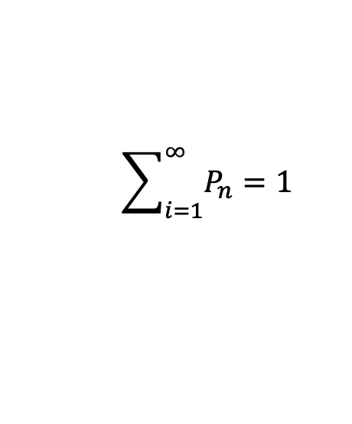
Results for M/M/k
Balance equation
How?
How?
$${\sum_{i=1}^{∞}{P_{n}}=1}_{}$$

Slide 35
Comparing systems
Q: Which is best for minimizing E[T]?
v
M/M/k
Splitting
M/M/1fast
μ
μ
μ
μ
λ
jobs
λ
jobs
λ
jobs
kμ
sec
sec
sec
μ
μ

Slide 36
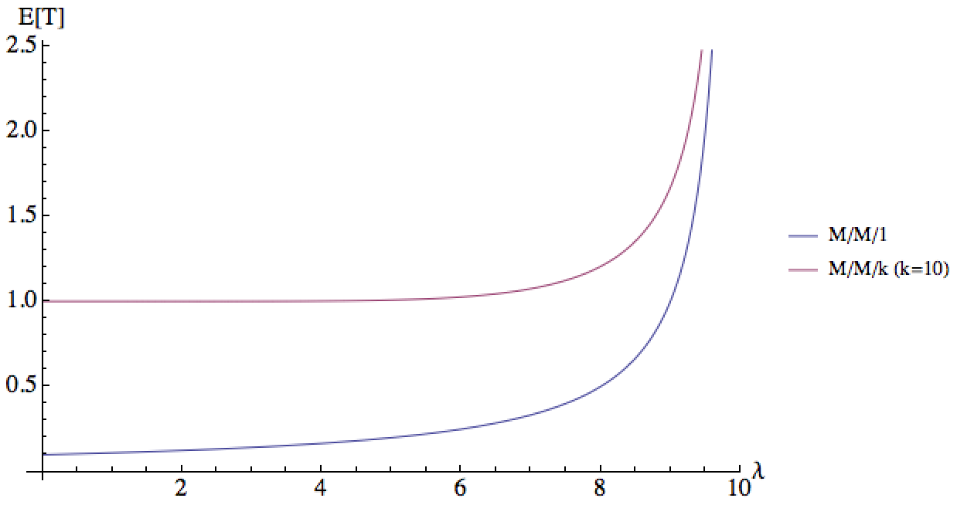




Many slow or 1 fast
Q: Which is best for minimizing E[T]?
v
Ε[Τ]
M/M/k
M/M/1fast
μ
2.0
μ
1.5
λ
jobs
M/M/10
λ
kμ
sec
1.0
jobs
sec
0.5
M/M/1fast
μ
λ
2
4
6
8
10
vs.

Slide 37



Many slow or 1 fast: variability
Q: What if
Ε[Τ]
Why??
v
M/G/k
M/G/1fast
μ
10
μ
M/G/1fast
λ
jobs
λ
kμ
sec
5
0
jobs
sec
μ
M/G/10
2
4
6
λ
Check: $P_{Q},$ probability an arrival has to queue

Slide 38
Proportional scaling is over killed
μ
μ
μ
M/M/2
M/M/4
M/M/8
2λ
μ
μ
4λ
8λ
μ
μ
μ
μ
P_{Q}
E[T_{Q}]
M/M/4
M/M/4
1.0
0.6
M/M/2
0.6
0.4
M/M/2
M/M/8
M/M/8
0.2
0.2
0
λ
0
λ
0.2
0.4
0.6
0.8
1.0
0.2
0.4
0.8
1.0
38

Slide 39
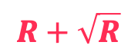
Many slow or 1 fast: variability
μ=1
QUESTION: If arrival rate becomes 10⁶ times higher,
how many servers do we need to keep P_{Q} the same:
(a) 9.1 × 10⁶ (b) 10 × 10⁶ (c) 11 × 10⁶ (d) 12 × 10⁶ (e) 13 × 10⁶
μ=1
9
jobs
sec
μ=1
12 servers
μ=1
“Square root staffing”
[Halfin, Whitt OR 1981]
Let R be the minimum #servers for stability.
Then servers yields P_{Q} = 20%.
μ=1
9x10⁶
jobs
sec
$$R+\sqrt{R}$$
μ=1

Slide 40
Queueing network

Slide 41
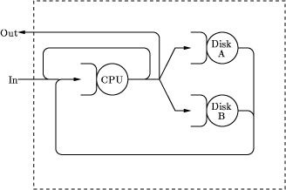
Open Queueing Networks
Queueing Network: model in which jobs departing from one queue arrive at another queue (or possibly the same queue)
Open queueing network: external arrivals and departures
Number of jobs in the system varies with time.
Throughput = arrival rate
Goal: To characterize the distribution of number of jobs n the system.

Slide 42
Closed Queueing Networks
Closed queueing network: No external arrivals or departures
Total number of jobs in the system is constant
`OUT' is connected back to `IN.'
Throughput = flow of jobs in the OUT-to-IN link
Number of jobs is given, determine the throughput

Slide 43
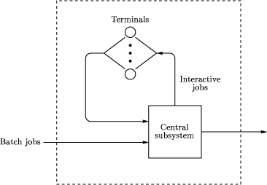
Mixed Queueing Networks
Mixed queueing networks: Open for some workloads and closed for others ⇒ Two classes of jobs. Class = types of jobs. All jobs of a single class have the same service demands and transition probabilities. Within each class, the jobs are indistinguishable.

Slide 44
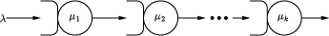
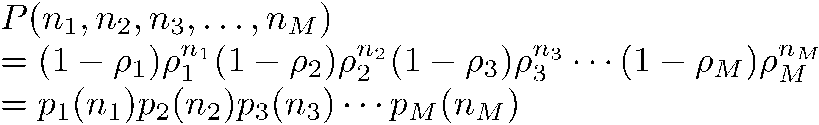
Series Networks
k M/M/1 queues in series
Each individual queue can be analyzed independently of other queues
Arrival rate= λ. If μ_{i} is the service rate for i^{th} server:
Joint probability of queue lengths:

Slide 45
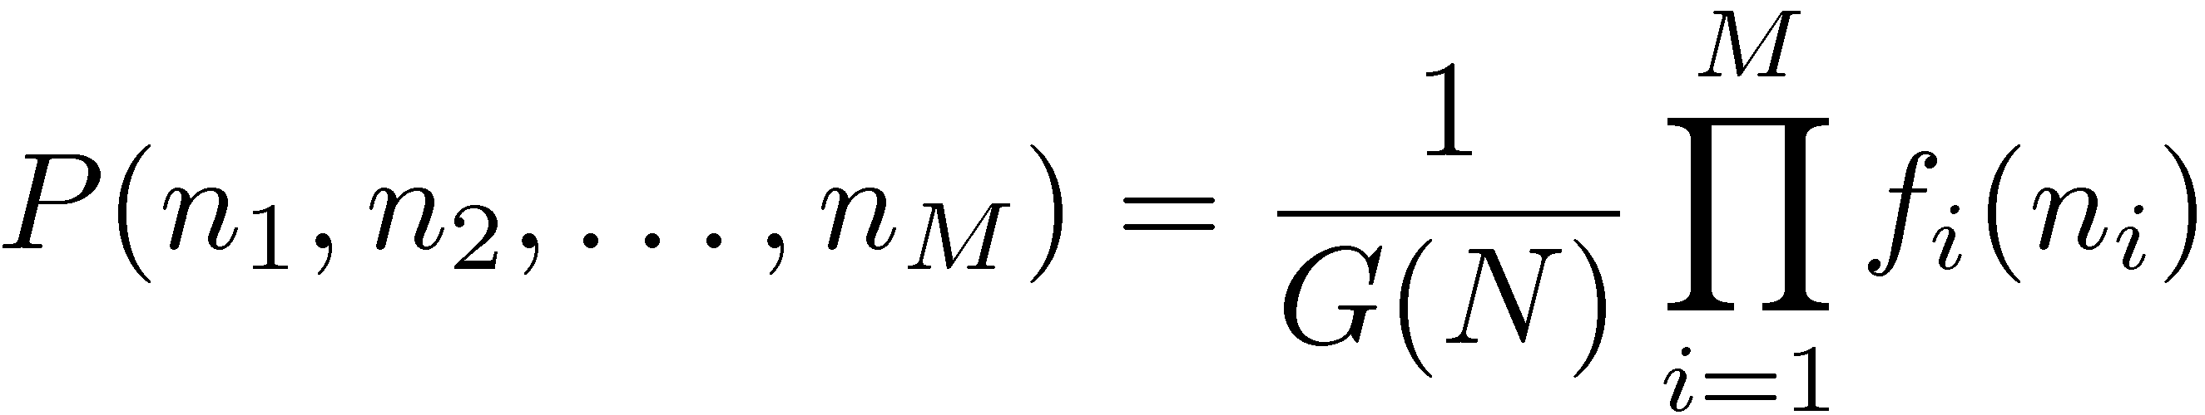
Product-Form Network
Any queueing network in which:
When f_{i}(n_{i}) is some function of the number of jobs at the ith facility, G(N) is a normalizing constant and is a function of the total number of jobs in the system.

Slide 46
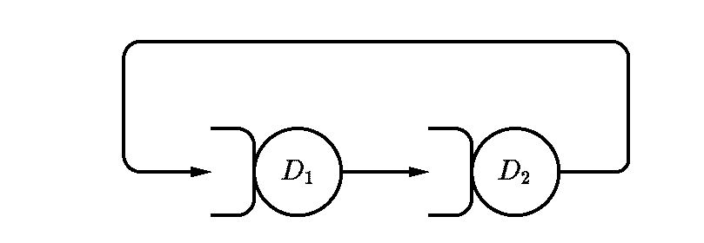
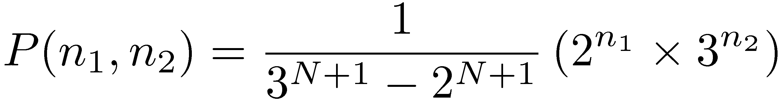
Example
Consider a closed system with two queues and N jobs circulating among the queues:
Both servers have an exponentially distributed service time. The mean service times are 2 and 3, respectively. The probability of having n₁ jobs in the first queue and n₂=N-n₁ jobs in the second queue can be shown to be:
In this case, the normalizing constant G(N) is 3^{N+1}-2^{N+1}.
The state probabilities are products of functions of the number of jobs in the queues. Thus, this is a product form network.

Slide 47
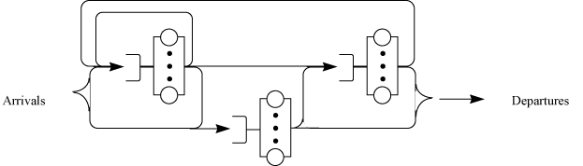
General Open Network of Queues (Jackson)
If all queues are single-server queues, the queue length distribution is:
Note: Queues are not independent M/M/1 queues with a Poisson arrival process.
In general, the internal flow in such networks is not Poisson. Particularly, if there is any feedback in the network, so that jobs can return to previously visited service centers, the internal flows are not Poisson.

Slide 48
Closed Product-Form Networks (BCMP)
Service Disciplines:
First-come-first-served (FCFS),
Processor sharing (PS),
Infinite servers (IS or delay centers), and
Last-come-first-served-preemptive-resume (LCFS-PR).
2. Job Classes: The jobs belong to a single class while awaiting or receiving service at a service center, but may change classes and service centers according to fixed probabilities at the completion of a service request.
3. Service Time Distributions:
At FCFS service centers, the service time distributions must be identical and exponential for all classes of jobs.
At other service centers, where the service times should have probability distributions with rational Laplace transforms;
Different classes of jobs may have different distributions.

Slide 49
BCMP Networks(Cont)
4. State Dependent Service:
The service time at a FCFS service center can depend only on the total queue length of the center.
The service time for a class at PS, LCFS-PR, and IS center can also depend on the queue length for that class, but not on the queue length of other classes.
Moreover, the overall service rate of a subnetwork can depend on the total number of jobs in the subnetwork
5. Arrival Processes:
In open networks, the time between successive arrivals of a class should be exponentially distributed.
No bulk arrivals are permitted.
The arrival rates may be state dependent.
A network may be open with respect to some classes of jobs and closed with respect to other classes of jobs.

Slide 50
Example of QN

Slide 51
Summary
Product Form Networks
DB
BCMP
Jackson
Product form networks: Any network in which the system state probability is a product of device state probabilities
Jackson: Network of M/M/m queues
BCMP: More general conditions
Denning and Buzen: Even more general conditions

Slide 52
Bonus quiz

Slide 53
Next lecture:

Slide 54
Thanks!
Any questions?
y.chen-10@tudelf.nl
lydiaychen@ieee.org

Slide 55
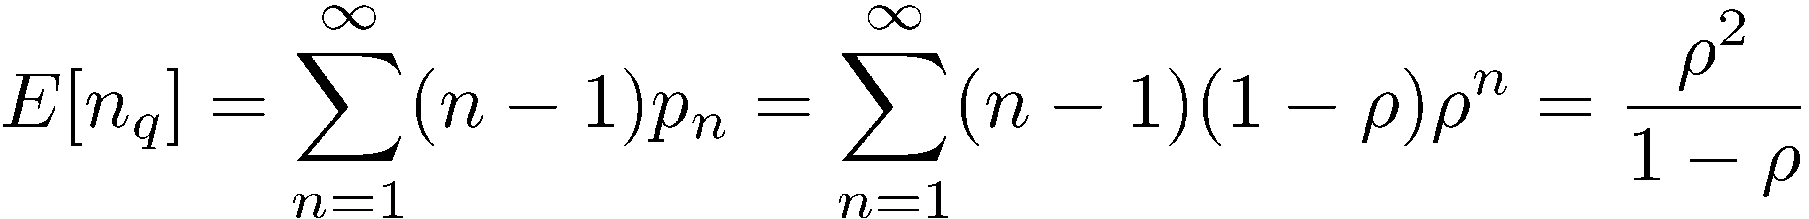
Results for M/M/1 Queue(Cont)
Mean number of jobs in the queue:
Idle ⇒ there are no jobs in the system
The time interval between two successive idle intervals

Slide 56
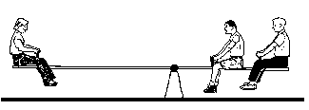
Load balancing
p
μ=2
Poisson
process
with rate
λ
jobs
sec
1-p
μ=1
QUESTION: What is the optimal p to minimize E[T]?
(a) (b) (c)
Notes:
Hi, My name is Mor Harchol-Balter. I’m a professor in the Computer Science Department here at CMU. I’ll be talking about what analytical performance modeling teaches us about designing computer systems. Don’t get nervous about these friends of mine … you’ll meet them all later during the talk….

Slide 57
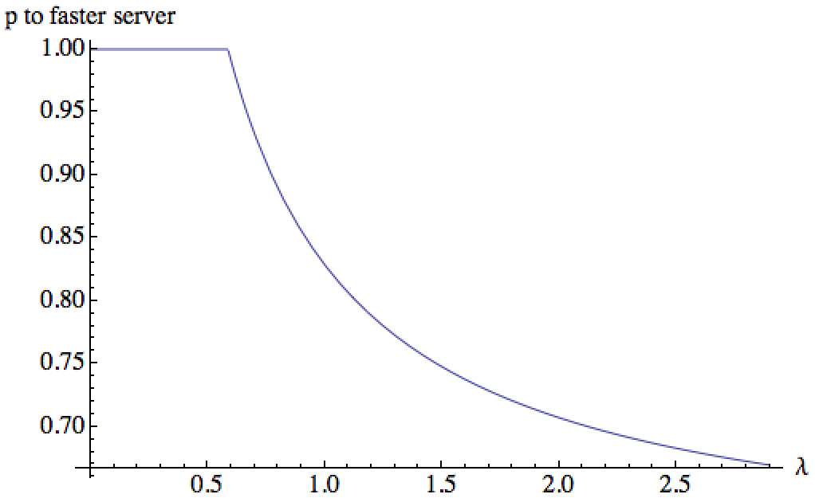

Load balancing
p
μ=2
Poisson
process
with rate
λ
jobs
sec
1-p
μ=1
Opt p
p=1
throw away
slower server
1.0
0.9
0.8
0.7
λ
1.0
2.0
3.0
Notes:
Might mention that for closed systems want to balance load.

Slide 58
Presentation design
This presentations uses the following typographies and colors:
Titles: Raleway
Body copy: Lato
You can download the fonts on these pages:
https://www.fontsquirrel.com/fonts/raleway
https://www.fontsquirrel.com/fonts/lato
Dark blue #2185c5
Light blue #7ecefd
Yellow #ff9715
Magenta #f20253
Dark gray #677480
Light gray #97abbc
You don’t need to keep this slide in your presentation. It’s only here to serve you as a design guide if you need to create new slides or download the fonts to edit the presentation in PowerPoint®

Slide 59
SlidesCarnival icons are editable shapes.
This means that you can:
Resize them without losing quality.
Change fill color and opacity.
Change line color, width and style.
Isn’t that nice? :)
Examples:

Slide 60
😉
Now you can use any emoji as an icon!
And of course it resizes without losing quality and you can change the color.
How? Follow Google instructions https://twitter.com/googledocs/status/730087240156643328
✋👆👉👍👤👦👧👨👩👪💃🏃💑❤😂😉😋😒😭👶😸🐟🍒🍔💣📌📖🔨🎃🎈🎨🏈🏰🌏🔌🔑 and many more...

